Slide 1
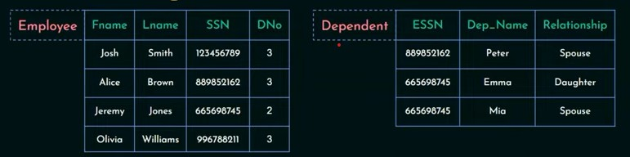

Example 1:

Slide 2

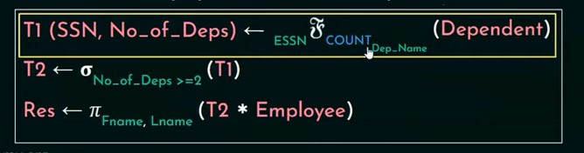



1. List names of all employees with 2 or more dependents.

Slide 3
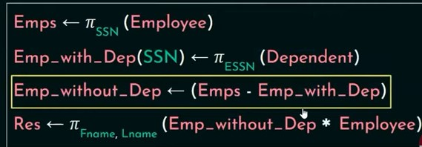
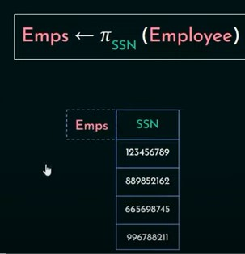

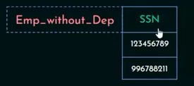


2. Retrieve names of employees with no dependents

Slide 4
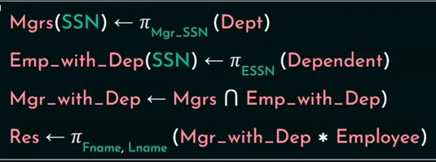

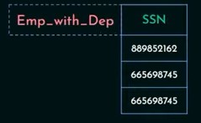


3. List the names of managers who have at least one dependent.

Slide 5
Example 2:
1. Consider a database with the following schema:
Person ( name, age, gender ) | name is a key
Frequents ( name, pizzeria ) | (name, pizzeria) is a key
Eats ( name, pizza ) | (name, pizza) is a key
Serves ( pizzeria, pizza, price ) | (pizzeria, pizza) is a key

Slide 6

a. Find all pizzerias frequented by at least one person under the age of 18.

Slide 7
b. Find the names of all females who eat either mushroom or pepperoni pizza(or both).

Slide 8

c. Find the names of all females who eat both mushroom or pepperoni pizza.

Slide 9

d. Find all pizzerias that serve at least one pizza that Amy eats for less than $10.00.

Slide 10
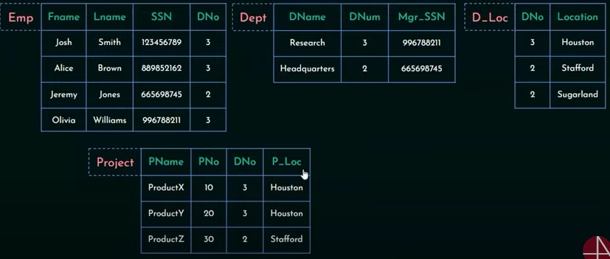
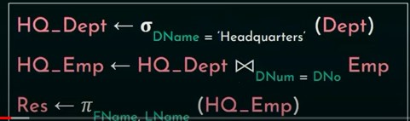
Query 1. Retrieve the names of all employees who work for the ‘Headquarters’ department.

Slide 11
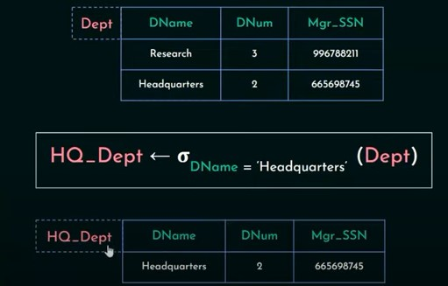
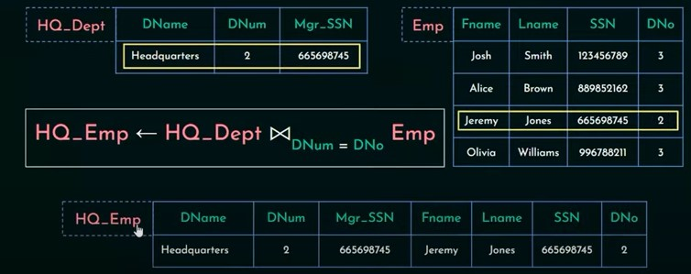
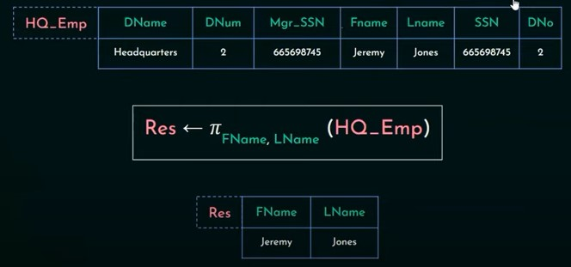

Slide 12
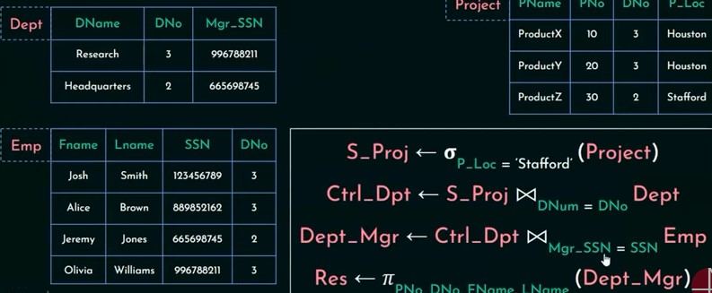
Query 2. For every project located in ‘Stafford’, list the project number, the controlling department number, and managers name.

Slide 13
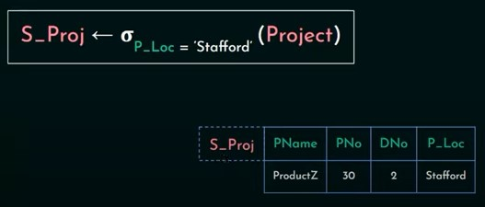
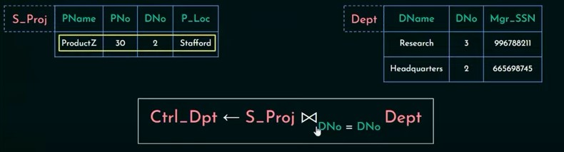

Slide 14
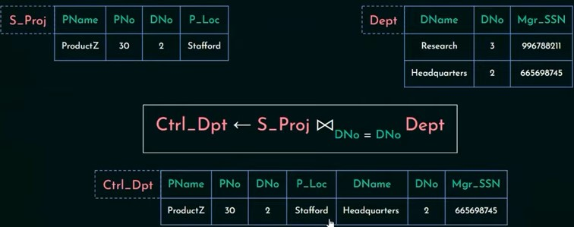



Slide 15


Slide 16
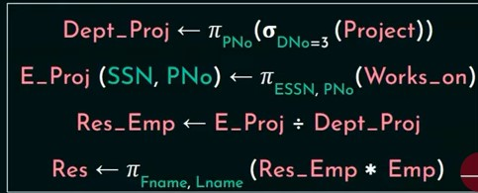
Query 3. Find the names of employees who work on all the projects controlled by DNo=3.

Slide 17
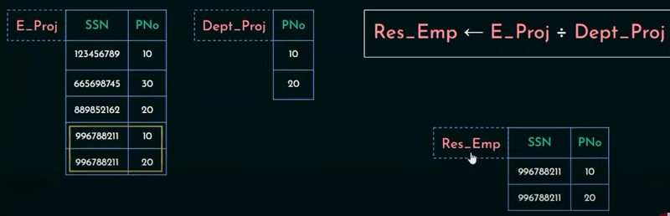
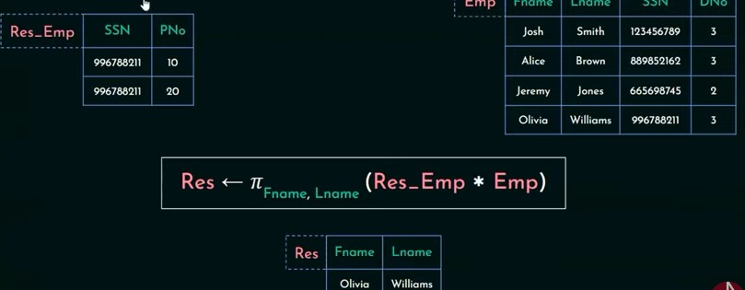

Slide 18
Example 3:
• lives(person-name,street,city)
• works(person-name, company-name,salary)
• located-in(company-name,city)
• manages(person-name,manager-name)
1. Find the name of all employees (i.e., persons) who work for the City Bank company (which is a specific company in the database).
πperson−name(σcname=′City Bank′(works))

Slide 19
2. Find the name and city of all employees who work for City Bank.
πlives.pname,lives.city(σ((cname=′City Bank′)∧(lives.pname=works.pname))(works × lives))

Slide 20
3. Find the name, street and city of all employees who work for City Bank and earn more than $10,000.
πlives.pname,street,city(σ((cname=′City Bank′)∧(lives.pname=works.pname)∧(salary>10000))(works×lives))

Slide 21
4.Find all persons who do not work for City Bank.
πpname(works − (σ(cname=′City Bank′) (works)))

